Slide 1
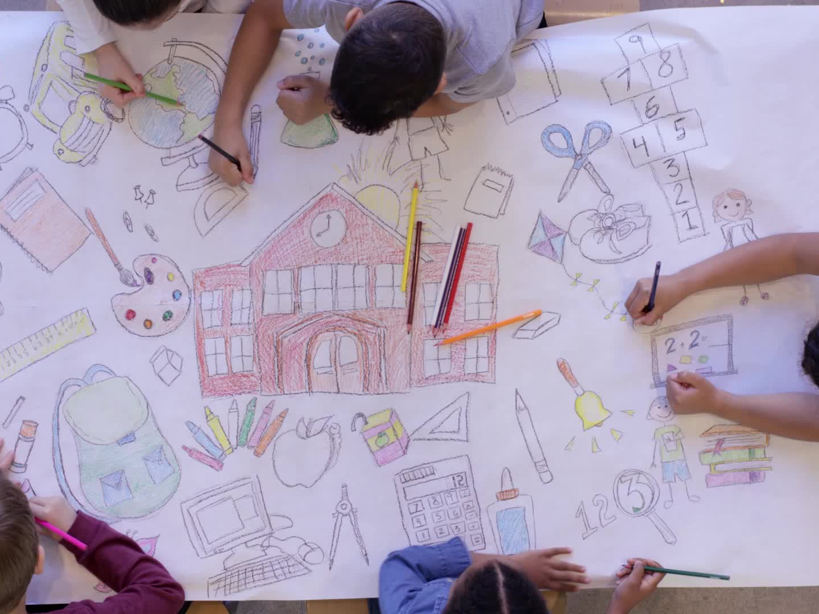
Title 1 at Northside Elementary School of the arts
September, 2024

Slide 2
What is Title 1?
Title 1 is a law under the Elementary and Secondary Education Act (ESEA) of 1965 which provides federal funds for compensatory educational services.
Northside instruction covers SC State Standards

Slide 3
What is Title 1?
Compensatory means “extra”.
Title 1 provides extra money for teachers, instructional assistants, funding for staff development, and additional materials and supplies in all subject areas for eligible schools.

Slide 4
How Do We Qualify For Title 1 Funds?
Title I schools within the district are selected based on information obtained from:
The 135th Day Attendance Count
The percentage of students who are on free and reduced lunch.
A poverty index for all of the schools in the district is determined and the schools are ranked from highest poverty index to lowest.
Northside is ranked 4th highest in the district.

Slide 5
Who Benefits from Title 1 Funds?
Northside’s poverty index was determined to be 73.96%
Because our poverty index is greater than 40%, we qualify as a Schoolwide Title 1 Program.
That means all students benefit from these extra funds and services.

Slide 6
What Do the Title 1 Funds Provide?
Northside’s allocation for the 2024-2025 school year is: $422,500.

Slide 7
What Do the Title 1 Funds Provide?
Instructional Interventionist – Small Group instruction for 4th and 5th Grades
Early Literacy Interventionists - Works 1-on-1 with 1st grade students & Small group instruction for K, 1st, 2nd and 3rd grade students
Instructional Assistant – Works with small groups of students in classrooms or pull-out settings.
Professional Development ~ Leader in Me, Arts Integration, Teacher Leadership
Instructional Supplies to support: all students, Math & ELA Instruction and Parent Engagement.

Slide 8
What Do the Title 1 Funds Provide?
Computer Software
Pebble Go! – Reading and Research database for 4K – 3rd grade students
Learning A-Z
Razkids
BrainPop
Bookflix (true, freedom, science)
Flowcabulary

Slide 9
What Do the Title 1 Funds Provide?
Parent and Family Support
Title 1 Parent and Family Engagement Nights – materials, supplies, food, etc.
Literacy Picnic, Lunch & Learn, Title I Meeting, Coffee with the Administration, etc.

Slide 10
Parent and Family Engagement
Parent participation and involvement are encouraged in all Title 1 Schools through:
Opportunities to visit classrooms
Parent-Teacher Conferences
Attending SIC & PTA meetings
Attending Title 1 Parent Nights
Offering recommendations and suggestions

Slide 11
Where Can You Find More Information
NSES Parent & Student Handbook
Overview of Title 1
Title 1 Newsletter
School Compact
Title 1 Project Review

Slide 12
Where You Can Find More Information
Title 1 link on our website
1
Copy of our Title 1 plan in the office
2
Request a copy from the principal
3
Share information every month at PTA and SIC meetings
4

Slide 13
School Renewal Plan (SRP)
CLIMATE
With the goal of 6.6% in 2029, NORTHSIDE ELEMENTARY will work to decrease Disagrees on the Climate Survey for Elementary and Middle School Student's STUDENT PERCEPTION OF SOCIAL PHYSICAL ENVIRONMENT to 12.6% in 2025, from a baseline on the 2023 Survey of 14.1% for the Sum of Disagree.
TEACHER QUALITY
By 2025, 50.53% of 3rd grade; 58.76% of 4th grade; 60.93% of 5th grade students will score MEETS or EXCEEDS in ELA as measured by the SC Ready State Assessment from the baseline data of 3rd grade at 33.30%; 4th grade at 45.50%; 5th grade at 48.90% in 2023.
STUDENT ACHIEVEMENT
By 2025, 46.33% of 3rd grade; 44.87% of 4th grade; 53.20% 5th grade students will score MEETS or EXCEEDS in MATH as measured by the SC Ready State Assessment from the baseline data of 3rd grade at 29.50%; 4th grade at 27.30%; 5th grade at 39.80% in 2023.

Slide 14
Continuous Improvement Plan (CIP)
DATA
By the spring of 2025, 100% of teachers at NSES will use data to make student-driven instructional decisions as evidenced by targeted growth on formative and summative assessments.
PLC
By the spring of 2025, 100% of PLCs at NSES will engage in strategic vertical and interdisciplinary conversations in order to plan for and respond to student mastery of learning as evidenced by the district Collaborative Teams walkthrough tool – specifically, “The Work” components.
MTSS
During the 2024-2025 school year, Northside will focus on four areas of the MTSS CIP Continuum to move from Beginning to Developing on each indicator.
RESOURCE INEQUITY
By the 2025, the percentage of teachers who agree with the statement “Teachers have high expectations for student learning” will increase by 5%.

